Slide 1
TAS152
LECTURE 4
TOPIC 1
CYBER SOCIETY: CORE VALUES AND VIRTUES
1.4 USERS' MOTIVATION IN CYBERSPACE

Slide 2
CANVAS STUDENTS
Mukhesi Rauluswielo Tsiea Tshivhase
Claudia Brown
Cameronn Pita
Andiswa Olwethu
Kiara Esmael Nangy
Tlhaloso Neo Masegela

Slide 3
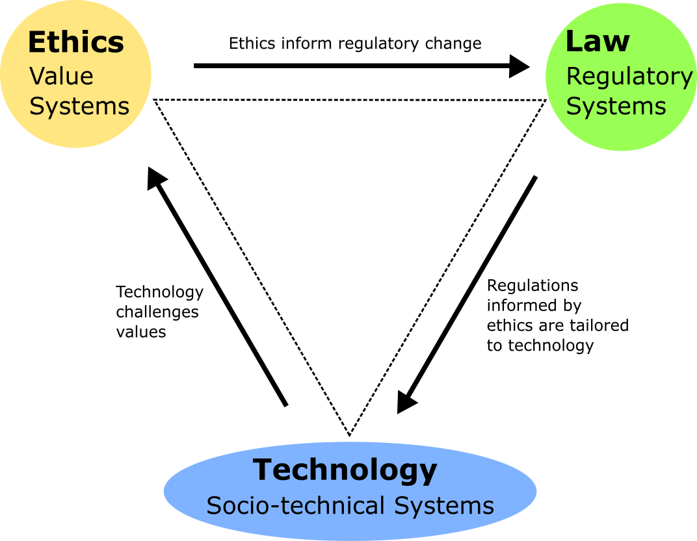
RECAP

Slide 4

USERS' MOTIVATION IN CYBERSPACE
Actions may have an ethically positive (constructive) or negative (destructive) impact.
Positive impacts
Access to online education
Maintaining close relationships
Establishing a professional identity
Negative impacts
Cyber bullying
Digital addiction
Religious/violent extremism.

Slide 5
CYBER-CITIZENSHIP
How can we try encourage ethically positive actions?
Cyber-citizenship
Digital literacy
Development of an autonomous, critical and responsible conscience
Work in the cyber world
Able to identify any dangers that this imposes
Able to know their rights and duties in this environment

Slide 6




CYBER-CITIZENSHIP
Does this actually help?
In short, yes.
Cyber-citizenship is not as effective for digital addiction.
What does help? Coping mechanisms
Self-regulation
Good sleep habits
Family dynamics
Real world activities

Slide 7
CYBERSPACE POST-FOURTH INDUSTRIAL REVOLUTION
Tying everything together...
We have cyberspace...
We have cyberspace existing after the fourth industrial revolution...
We have values for physical space...
What do we need?
Values that are applied in cyberspace...

Slide 8
CYBERSPACE POST-FOURTH INDUSTRIAL REVOLUTION
Existing principles
Dignity
Freedom
Honesty
Justice
Peace
Privacy
Participation
Integrity
Inclusiveness
Equity
Security

